Slide 1
mono
Alternative CLR Implementation

Slide 2

what is mono
An open source, cross-platform, implementation of C# and the CLR that is binary compatible with Microsoft.NET
A .NET application framework that allows you to run .NET-based applications on Linux Enterprise Server

Slide 3

why mono
stackoverflow.com

Slide 4
what’s inside
C#
F#
VB
Java
JS
Boo
PHP
LUA
Base Class Library
Mono Libraries
Mono.Addins
Core
ADO.NET
ASP.NET
Mono.Cecil
LINQ
DLR
WCF
Mono.Unix
Mono Runtime
JIT
AOT
Notes:
Runtime – ECMA Common Language Infrastructure

Slide 5
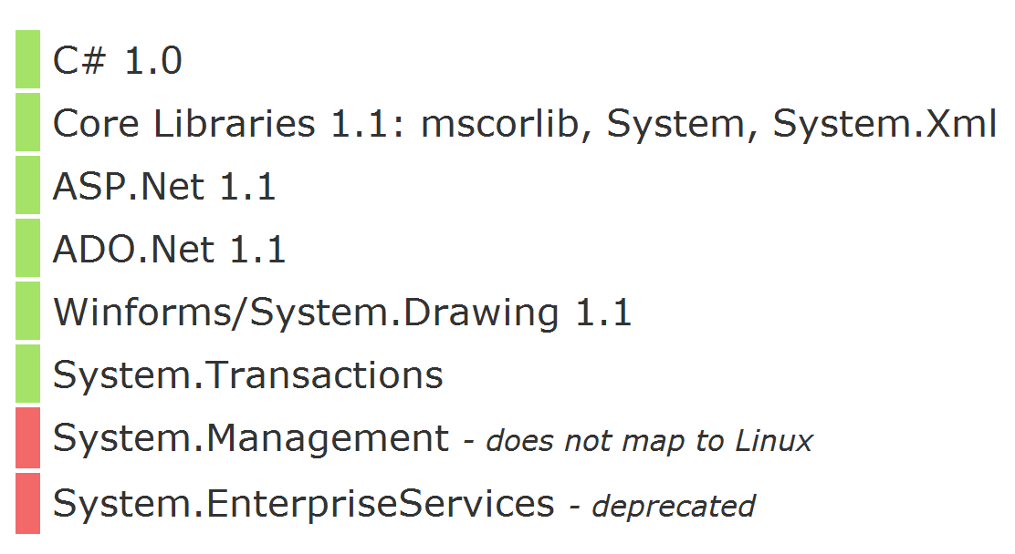
compatibility: .net 1.1

Slide 6
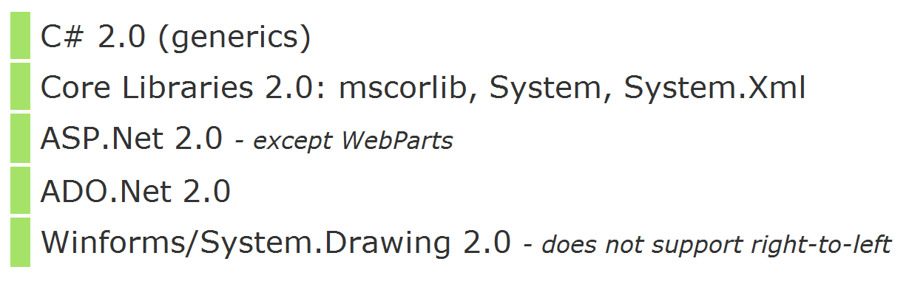
compatibility: .net 2.0

Slide 7
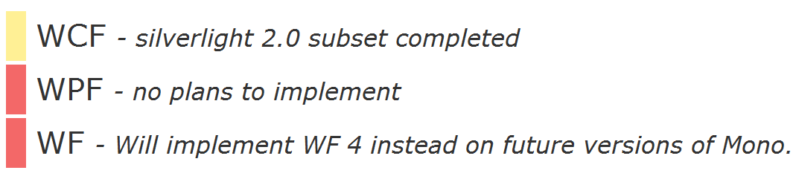
compatibility: .net 3.0

Slide 8
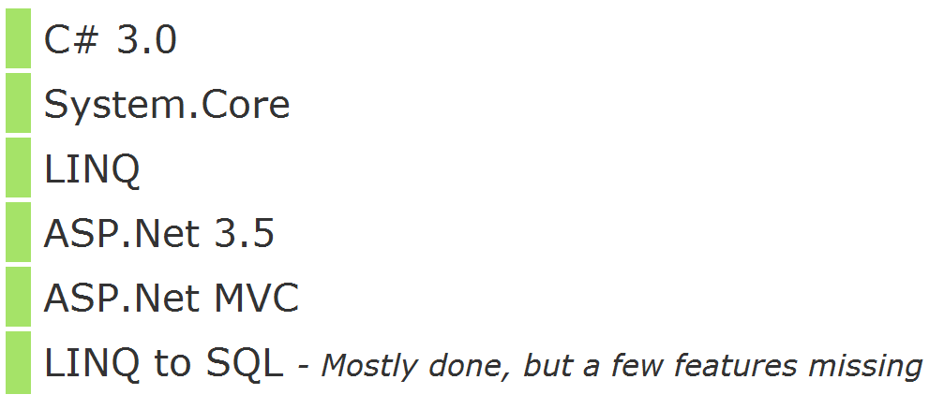
compatibility: .net 3.5

Slide 9
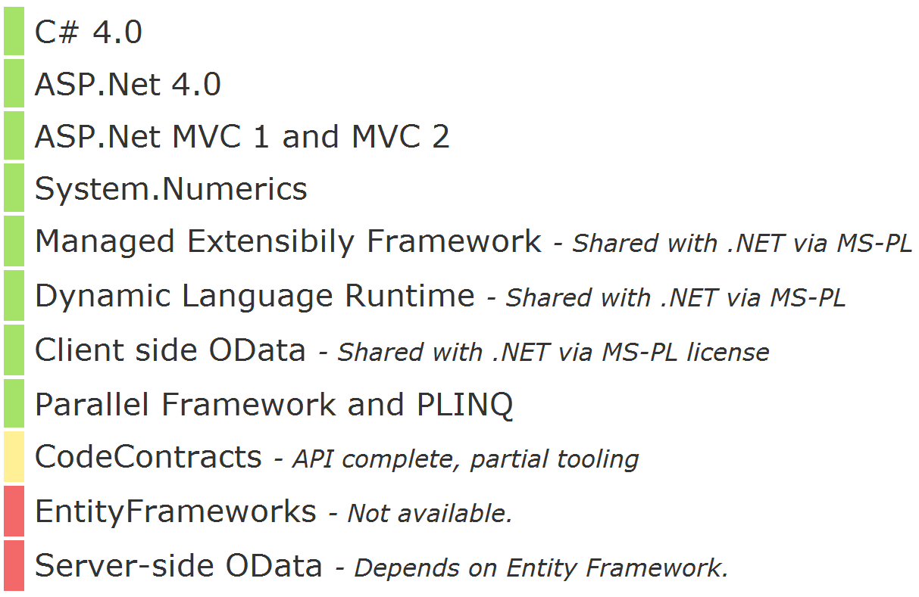
compatibility: .net 4.0

Slide 10

why use: #1
MONEY

Slide 11

why use: #2
OS Compatibility
Linux
Windows
Mac OS X
BSD
Solaris
Nintendo WII
Sony PS3
Apple iPhone
Google Android
Maemo

Slide 12
why use: #3 (Added values)
log4net
NUnit
NHibernate
Unity
Castle Windsor
and more…

Slide 13
why use: #4 (Added values)
Linux & Shell
MySQL & PgSQL
RabbitMQ
Mono Shell
Monodevelop
Moonlight
Monotouch
Monodroid

Slide 14

Tools:

Slide 15
Thank You

